Slide 1
The Common Core
Viewed through the prism of the Revised Bloom’s Taxonomy

Slide 2
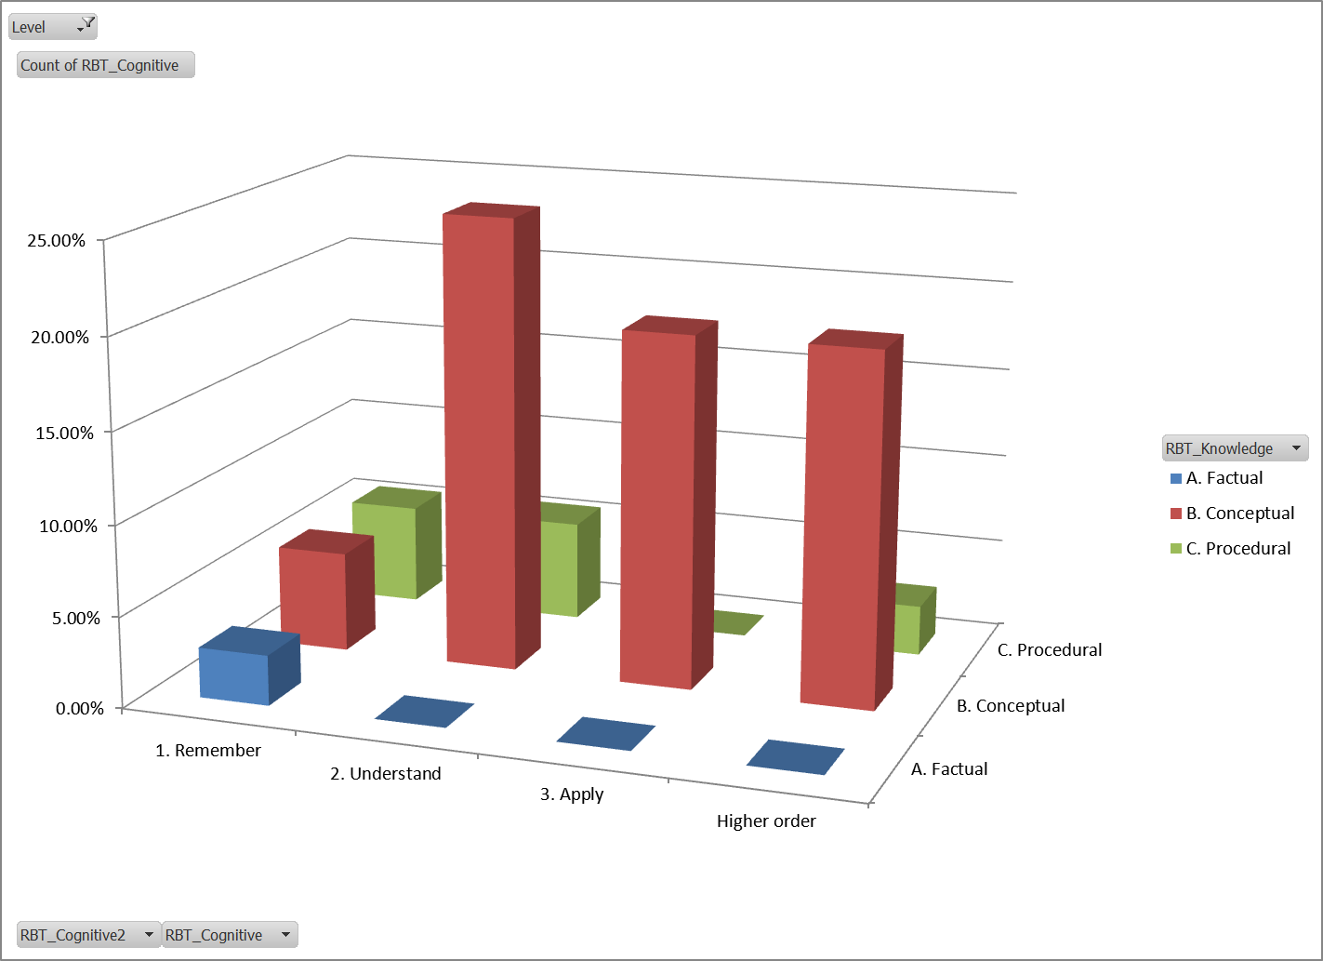
Kindergarten

Slide 3
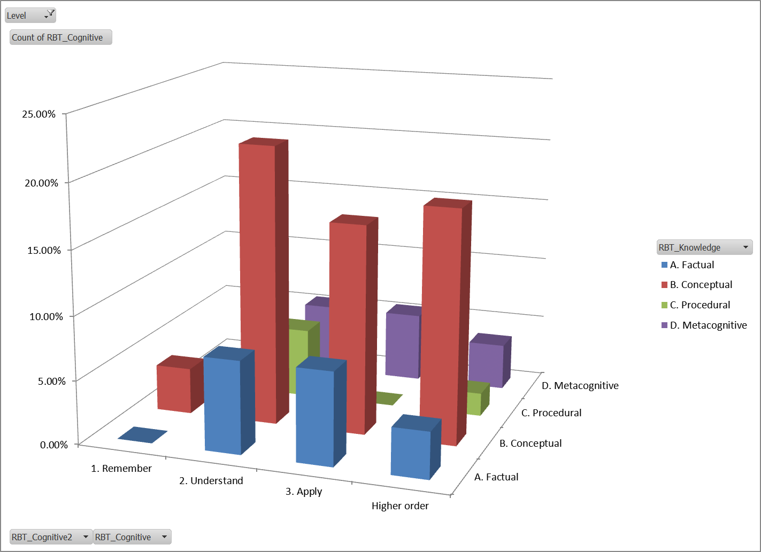
Grade 1

Slide 4
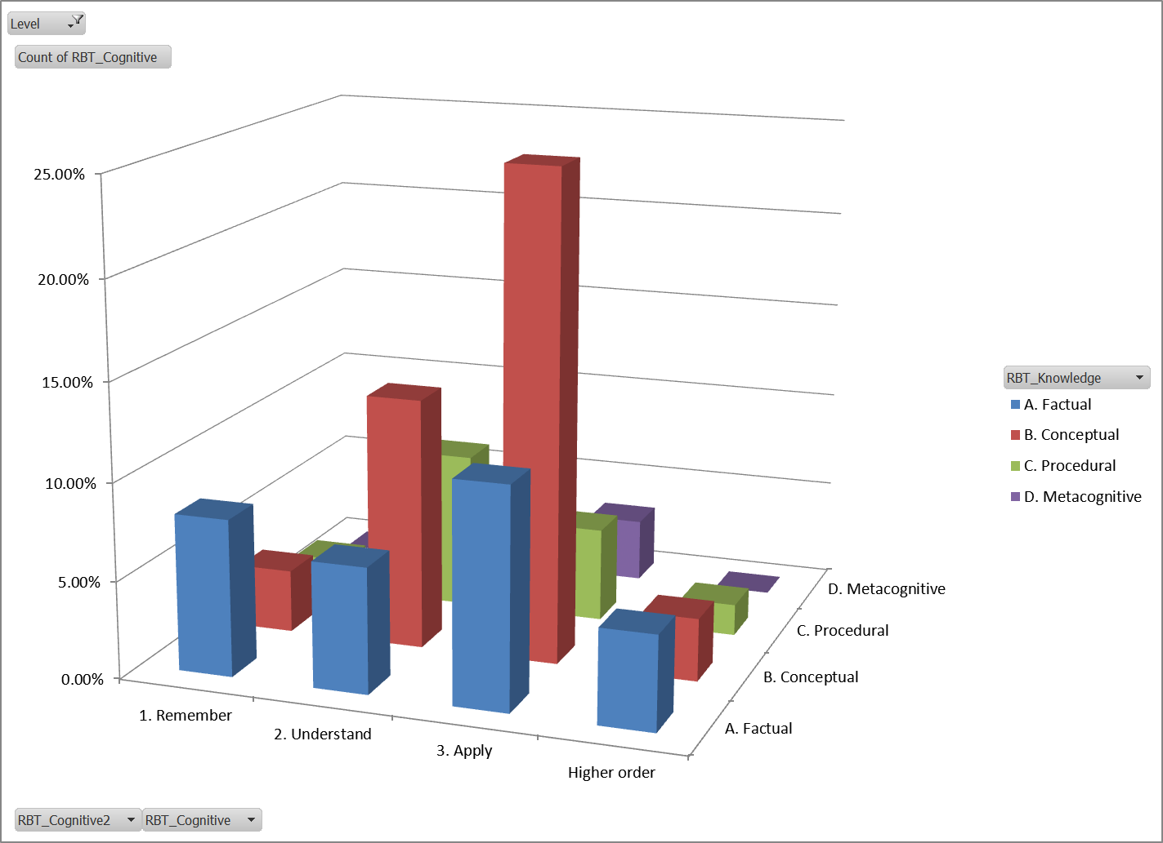
Grade 2

Slide 5
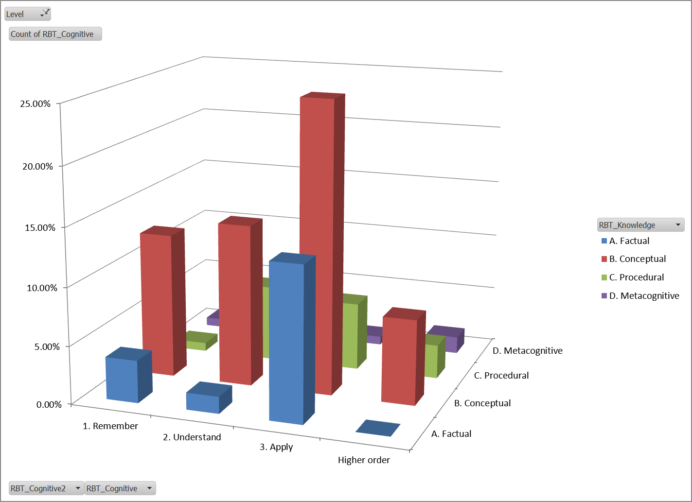
Grade 3

Slide 6
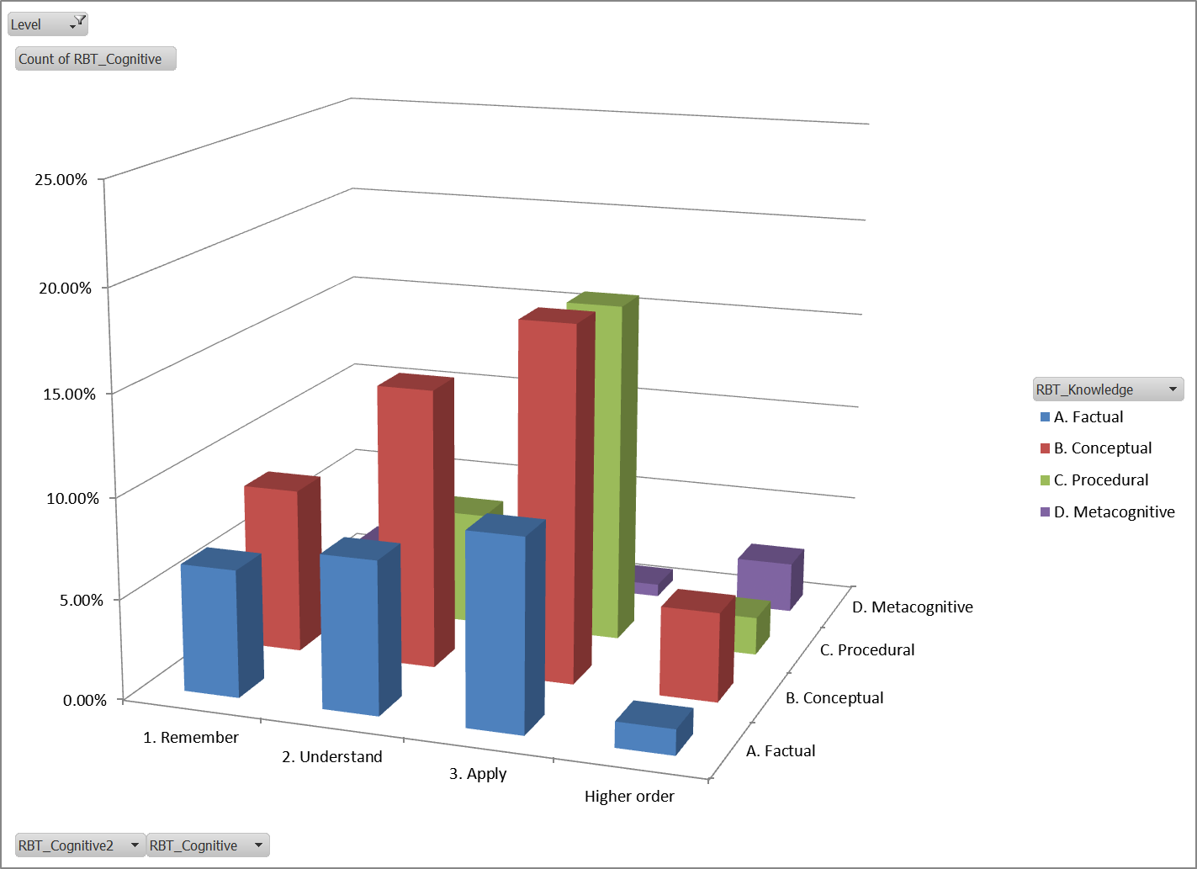
Grade 4

Slide 7
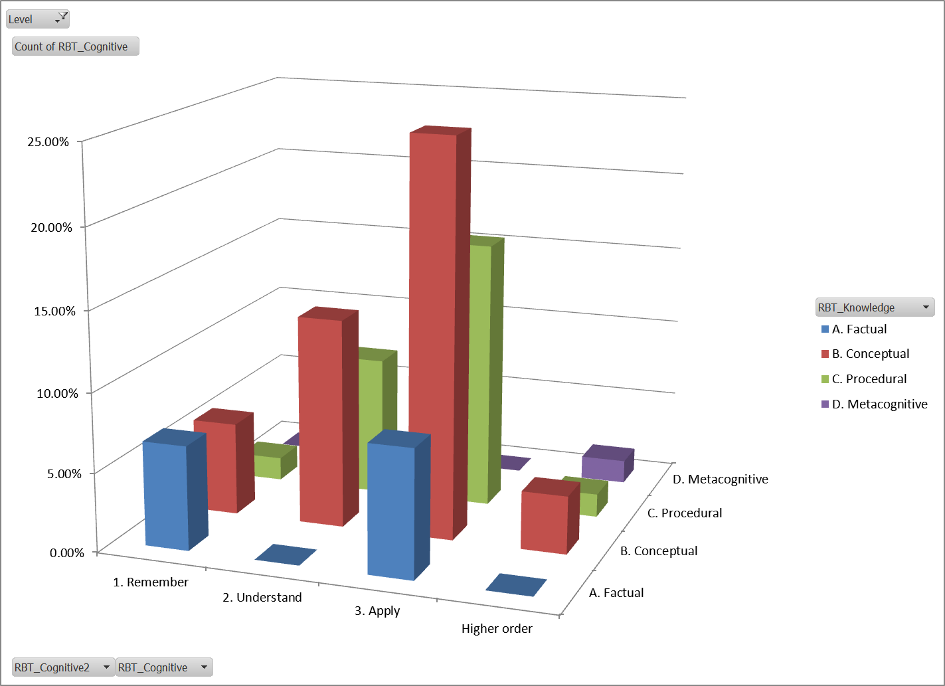
Grade 5

Slide 8
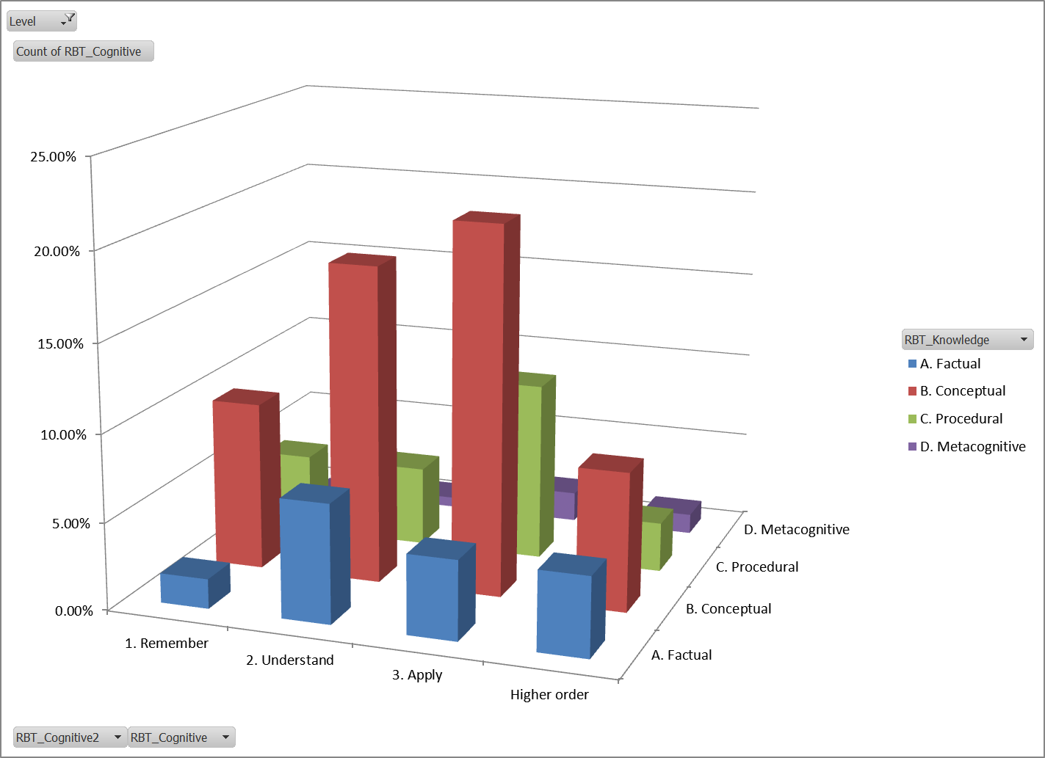
Grade 6

Slide 9
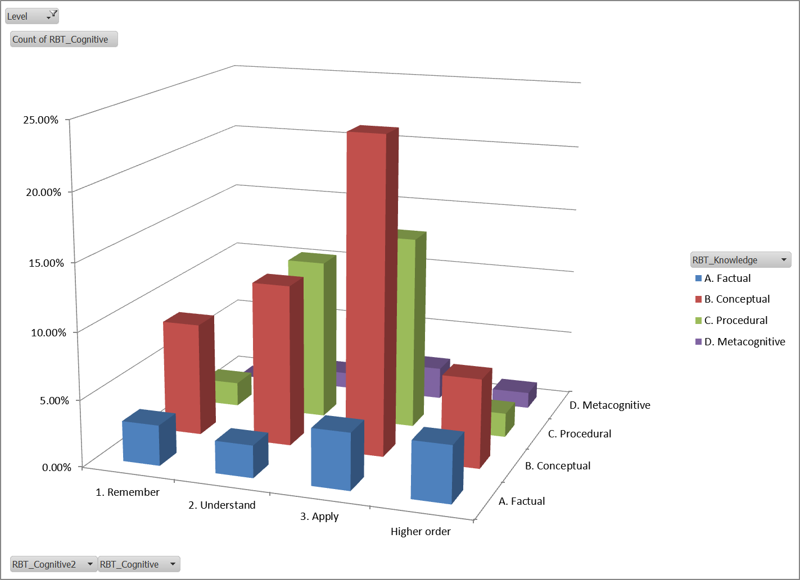
Grade 7

Slide 10
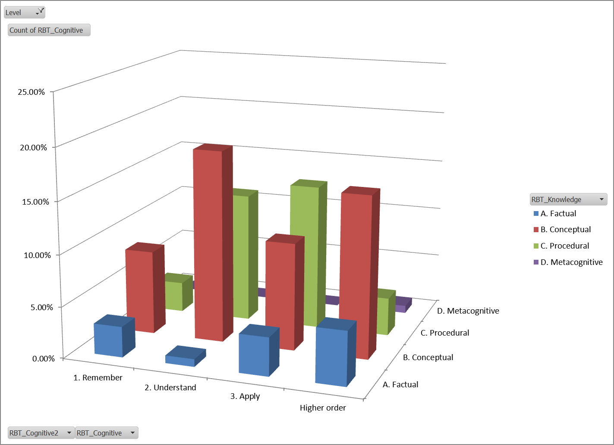
Grade 8

Slide 11
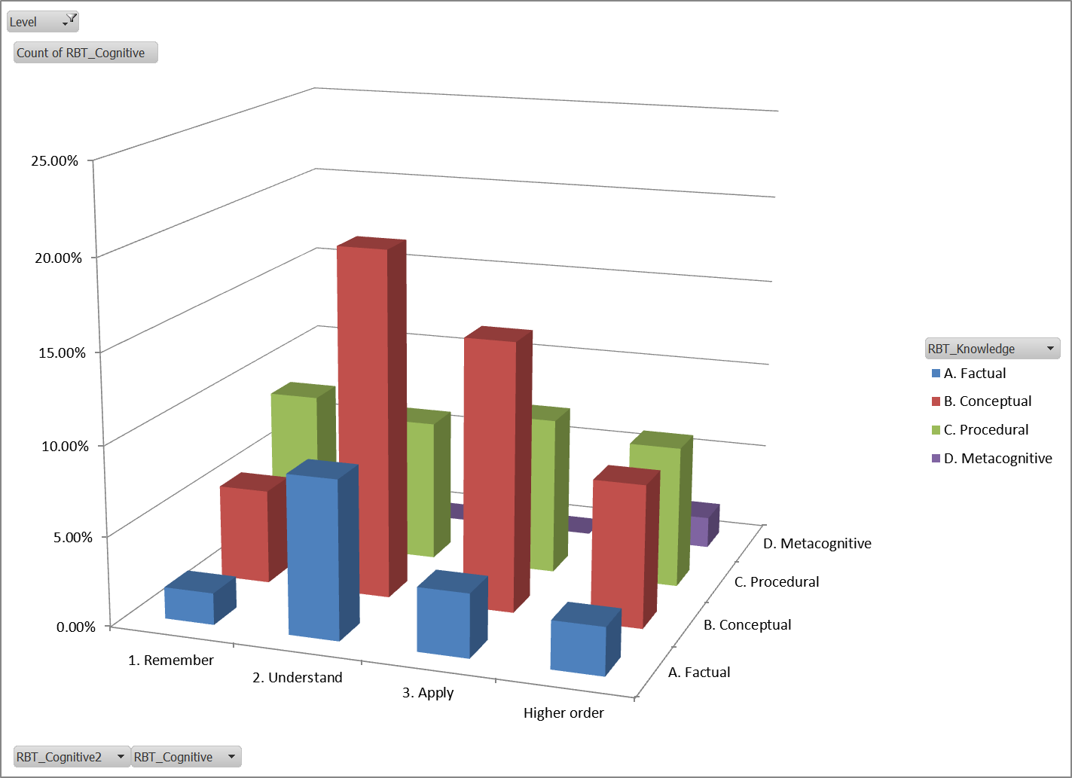
HS: Functions

Slide 12
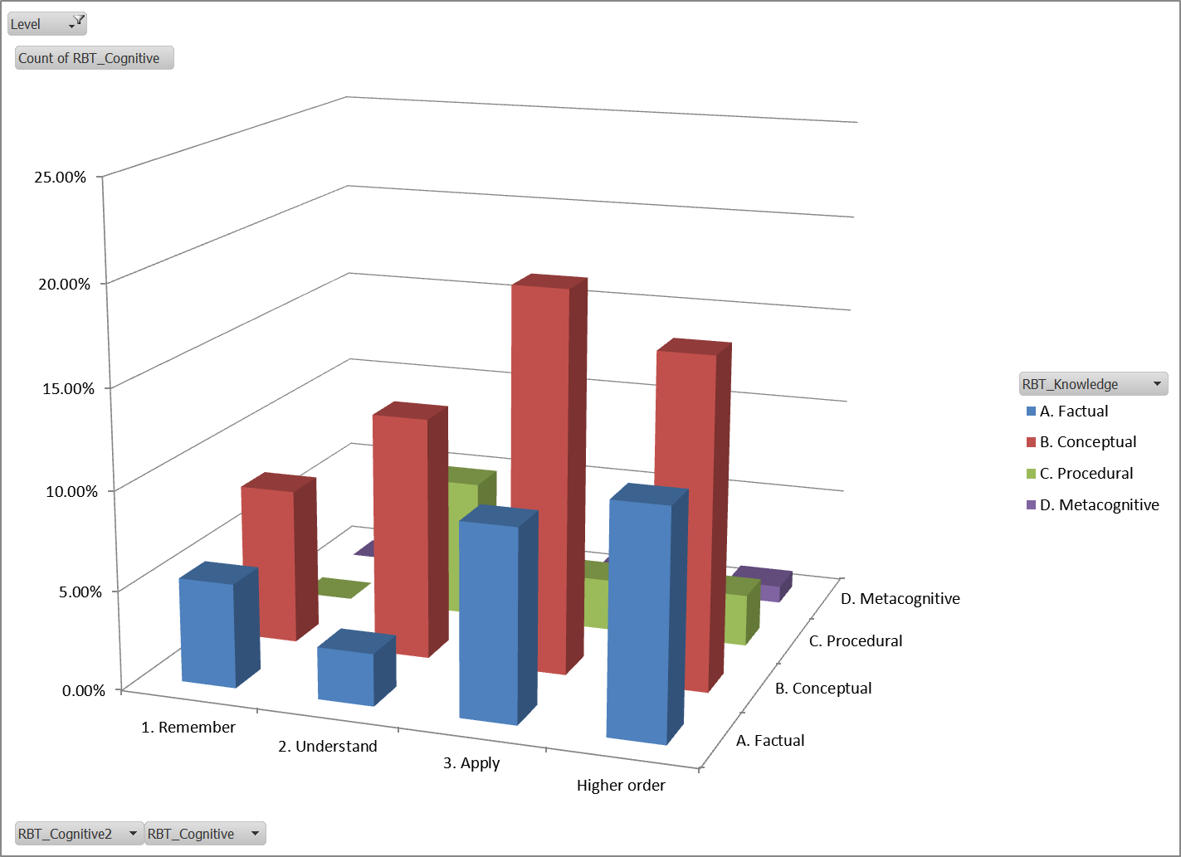
HS: Geometry

Slide 13
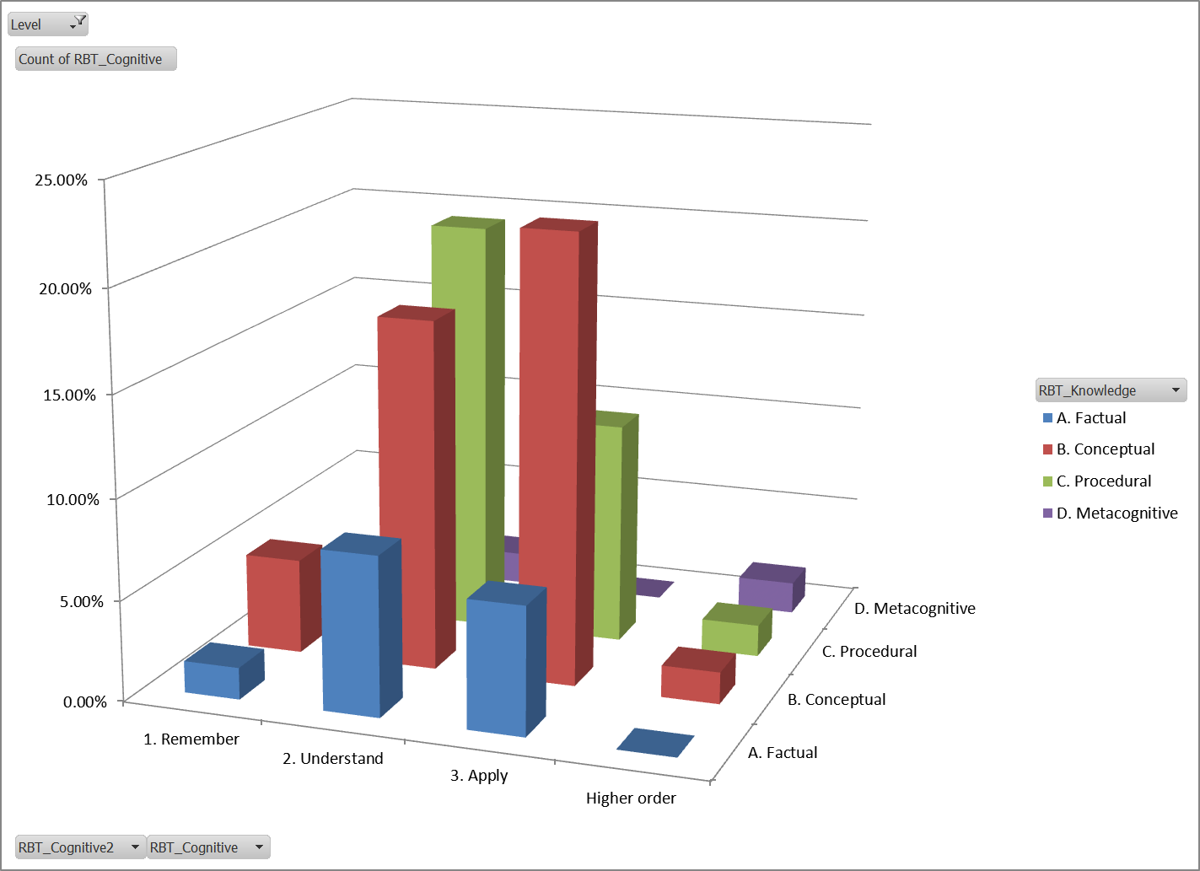
HS: Number

Slide 14
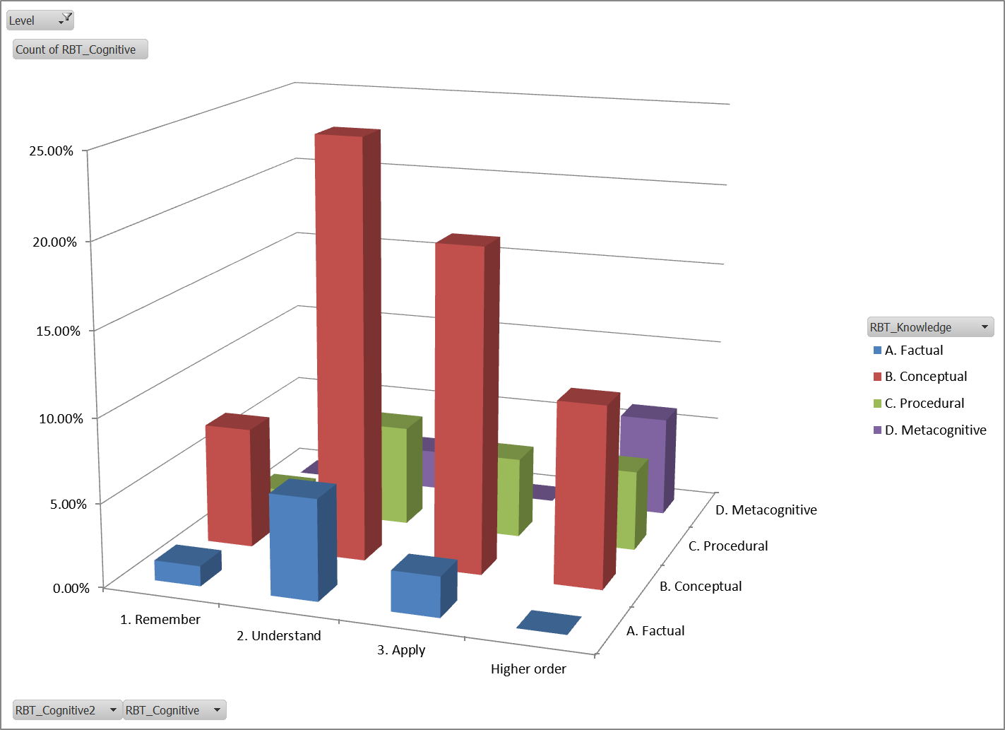
HS: Statistics

Slide 15
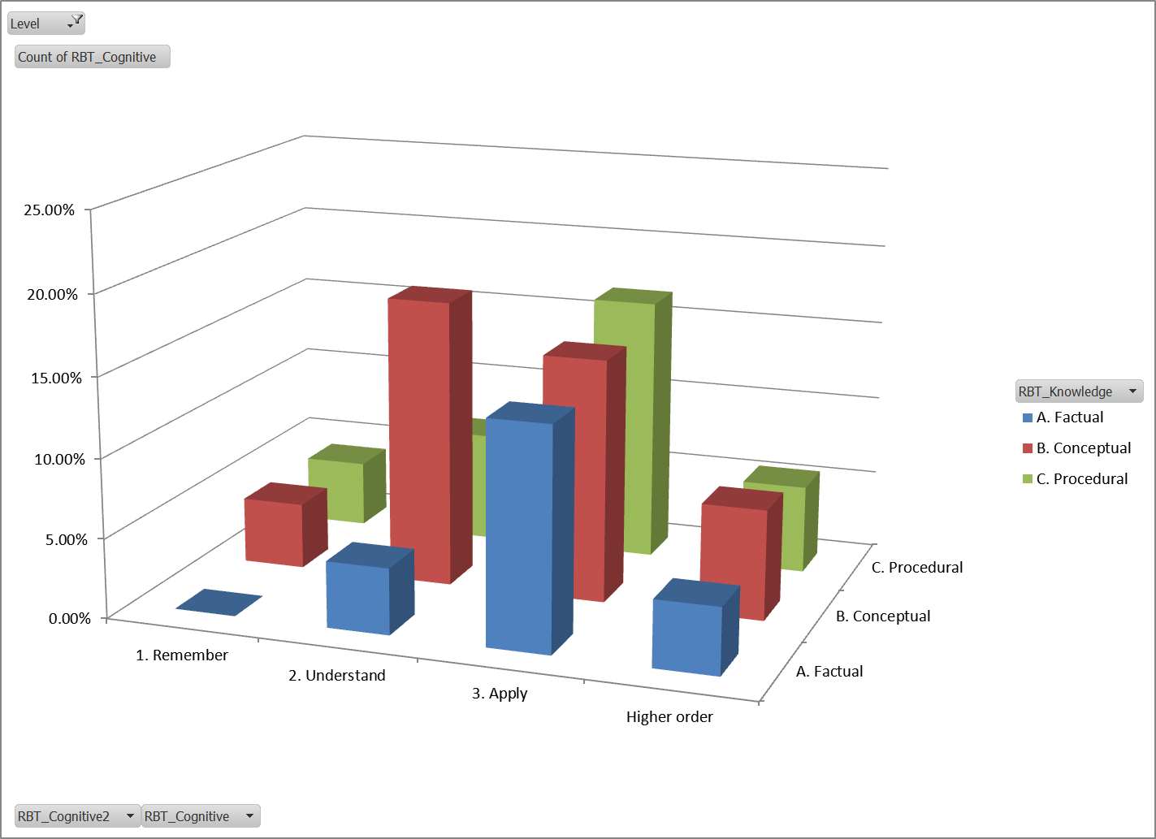
HS: Algebra

