Slide 1
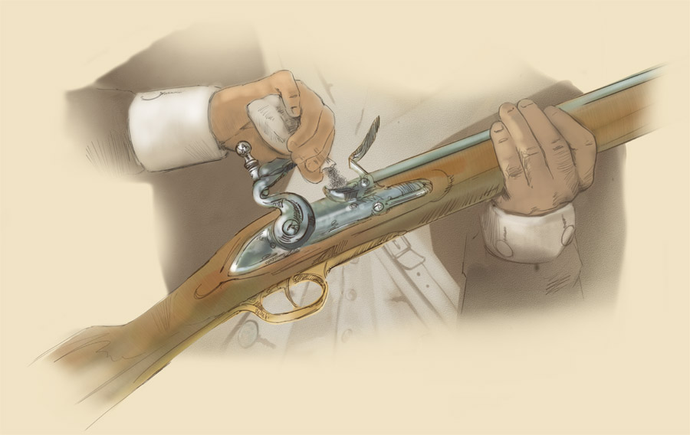
The Battle of Lexington and Concord
Grade: 4
By: Patrick Best
Lesson Plan

Slide 2
Table of Contents
1. Where is Lexington and Concord?
2. When did this happen?
3. Quick Quiz!!
( Question 1)
(Correct)
(Wrong)
4. Who?
5. Background Facts
6. Facts of the 18th and 19th
7. “Shot Heard Around the World”
8. Concord
9. Quiz
(Question 1)
(Question2)
(Question3)
(Question 4)
(Question 5)
(Correct)
(Wrong)
(All Correct)

Slide 3
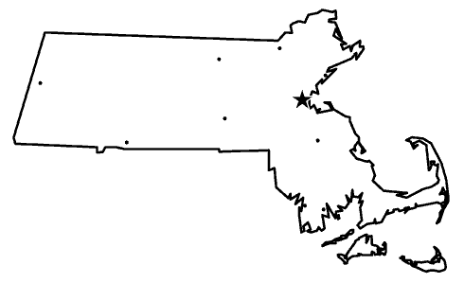
Where is Lexington and Concord?
Both these towns are in the colony of Massachusetts in the time of 1775.
Lexington
Concord
All 13 colonies here: http://www.socialstudiesforkids.com/graphics/13mapnew.htm

Slide 4
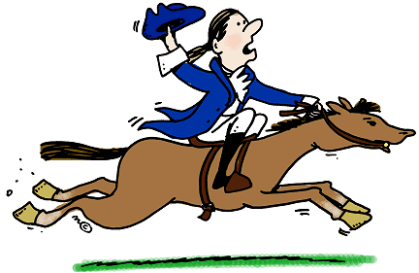
When did this happen?
In the year of 1775.
Exact date is April 19th, 1775
Year after the Intolerable Acts of 1774
The day before, of the 18th is the date of Paul Revere’s famous ride through towns yelling “the British are coming!”

Slide 5
Quick Quiz!!!

Slide 6
Where is Lexington & Concord?
1) England
2) South America
3) Lexington is in New York,
Concord is in Virginia
4) Massachusetts

Slide 7
Sorry that’s wrong
Try Again

Slide 8
Good Job!!!!!
Continue Lesson

Slide 9
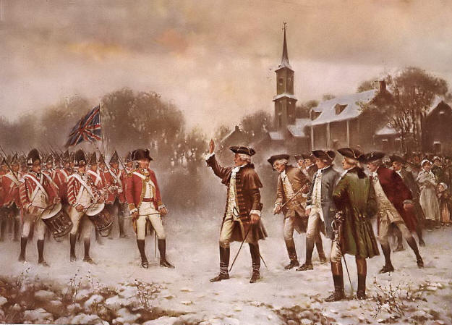
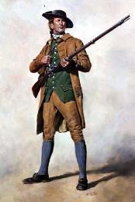
WHO??
Many people were involved in the battles of Lexington and Concord.
Broken down into the American Colonists and the British.
The American Colonists: Paul Revere, 70 Minutemen Militia, Captain Parker.
British: Lt. Colonel Francis Smith, 600-800 Soldiers.

Slide 10
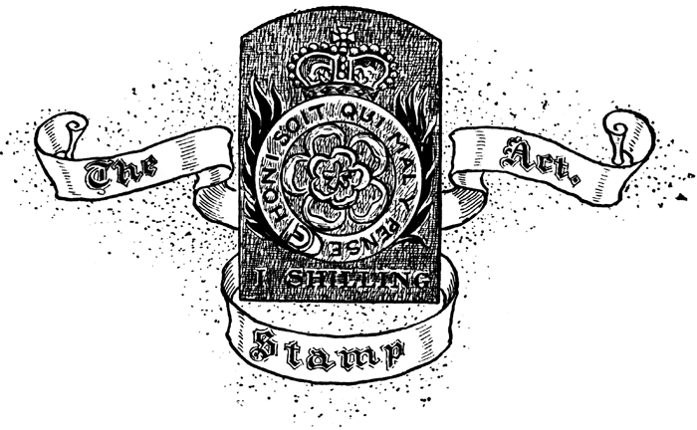
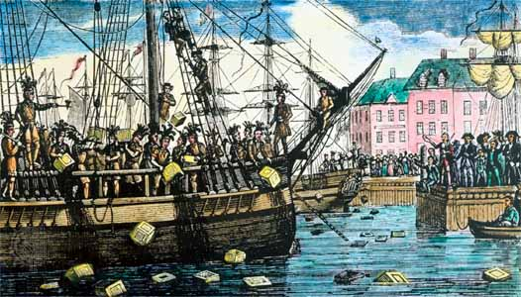
Background Facts
This will set up the stage for what occurred at Lexington and Concord….
.American Colonies were a part of Great Britain, and were being taxed to an outrageous amount.
.This was due to Great Britain needing to make money from debts from past wars.
.American Colonies were being outraged at the price of taxes and what was being taxed EX: stamps, tea, paper, etc..

Slide 11
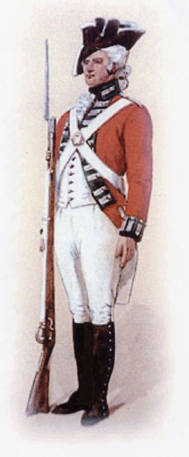
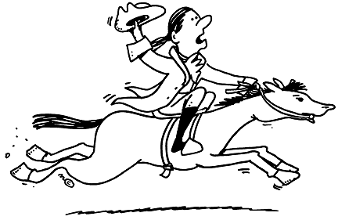
Facts of the 18th and 19th
From refusal to pay taxes and fear of rebellion, the British sent an army to stop transportation of weapons and seize all militias.
The 18th of April, Paul Revere caught wind of this and went to inform the people of Massachusetts.
Prepared for the arrival of the British Captain Parker had 70 Militia Minutemen to confront the British in Lexington.

Slide 12
“Shot Heard Around the World.”
When the British arrived in Lexington they were confronted by the 70 Minutemen.
They stood facing each other, as the Minutemen were informed not to fire upon the British unless the fire first, by Captain Parker.
All of a sudden a shot went off, and there was a scuffle between the two armies.
This was deemed “The Shot Heard Around the World,” since it was the key starting point of the Revolutionary War.
(Watch Video, http://www.youtube.com/watch?v=7VQA5NDNkUM )

Slide 13
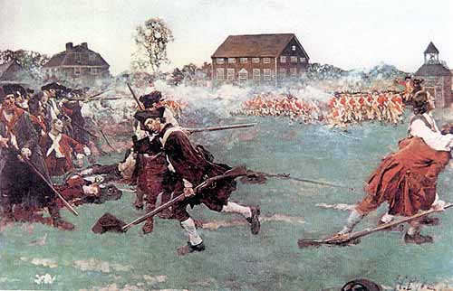
Concord
At Concord the British were trying to storm houses to capture any possible rebels.
The British were attacked with such a great force by the American Militia, that the British were forced to retreat to Boston!!
Thus, this was the start of the War of Independence!!

Slide 14
Quiz!!

Slide 15
Where is Lexington & Concord?
1) Australia
2) Louisiana
3) Massachusetts
4) Virginia

Slide 16
Who was involved?
1) The French and Indians
2) The British and The French
3) American Colonists and The British

Slide 17
When did this happen?
1) May 9th, 1975
2) July 4th 1776
3) April 18th and 19th, 1775

Slide 18
Why did the British go to the Colonies on April 19th 1775?
1) To celebrate the New Year
2) To start a new colony
3) To stop any possible rebellion

Slide 19
The “Shot Heard Around the World” is about…..?
1) The assassination of Franz Ferdinand
2) The last battle of the Revolutionary War
3) The first battle of the Revolutionary War

Slide 20
Congratulations!!! You now know all about Lexington and Concord!

Slide 21
Sorry, Wrong…. Try Again
Go to Question 1
Go to Question 2
Go to Question 3
Go to Question 4
Go to Question 5

Slide 22
Correct!!! Next Question…
Question 2
Question 3
Question 4
Question 5

